Slide 1
VPFNet For 3D Object Detection
15.02.2022

Slide 2
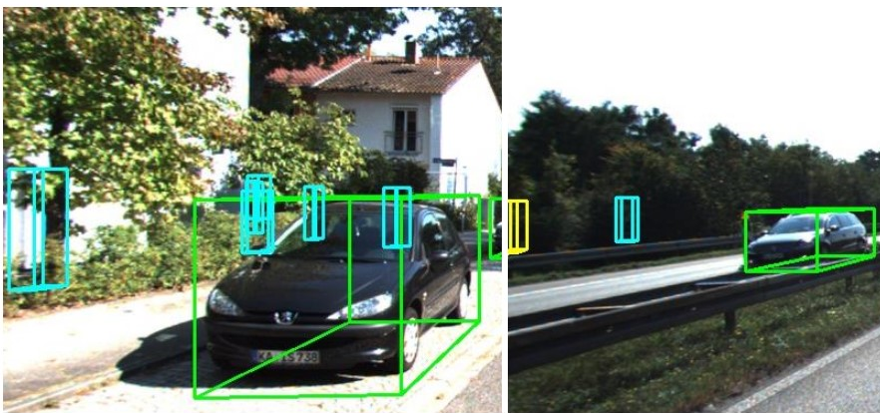
Problem
Many LiDAR-based methods for detecting large objects, single-class object detection, or under easy situations were claimed to perform quite well. However, their performances of detecting small objects or under hard situations did not surpass those of the fusion-based ones due to failure to leverage the image semantics.
PV-RCNN result

Slide 3
Solution

Slide 4
The paper proposes
A deep learning (DL)-embedded fusion-based multi-class 3D object detection network which admits both LiDAR and camera sensor data streams (VPFNet).
Inside this network, a key novel component is called Voxel-Pixel Fusion (VPF) layer, which takes advantage of the geometric relation of a voxel-pixel pair and fuses the voxel features and the pixel features with proper mechanisms.
The proposed method is evaluated on the KITTI benchmark for multi-class 3D object detection task under multilevel difficulty, and is shown to outperform all state-of-the-art methods in mean average precision (mAP). It is also noteworthy that our approach here ranks the first on the KITTI leaderboard for the challenging pedestrian class.

Slide 5
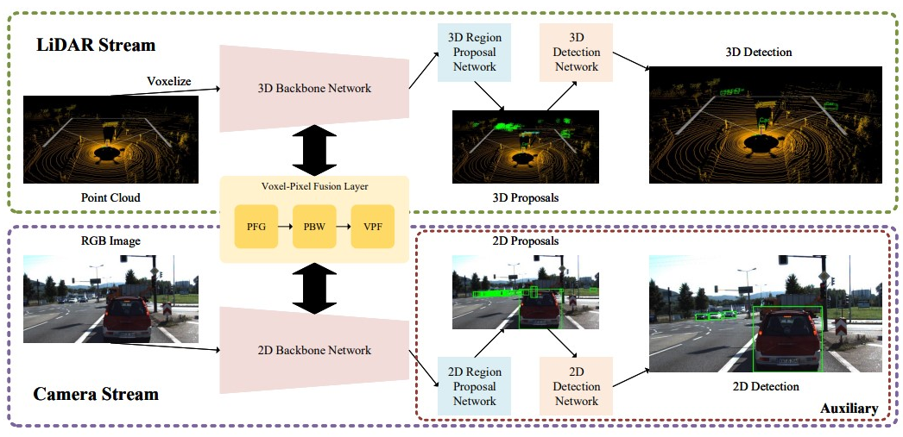
Model Architecture
Notes:
First, the LiDAR stream voxelizes the point cloud and utilizes a 3D backbone network to extract features. At the same time, the camera stream utilizes a 2D backbone network to extract features. Then, their feature maps are fed into the voxel-pixel fusion layer to fuse. Finally, the fused features are passed to the region proposal network and detection network to obtain the detection. Besides, the 2D detection task in the camera stream is auxiliary for training, which can be removed during inference time.

Slide 6
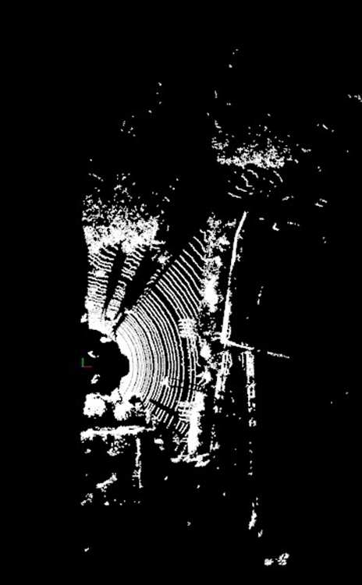
Data Preparation
The original training set, including 7,481 frames, is separated into a 3,712 training split a 3,769 validation split.
Velodyne point clouds (29 GB): input data
Training labels of object data set (5 MB): input label
Camera calibration matrices of object data set (16 MB): for visualization of predictions
Left color images of object data set (12 GB): for visualization of predictions
Using the cropped point cloud data for training and validation(15.6 GB) Point clouds outside the image coordinates are removed.
Notes:
https://github.com/gkadusumilli/Voxelnet#data-preparation

Slide 7
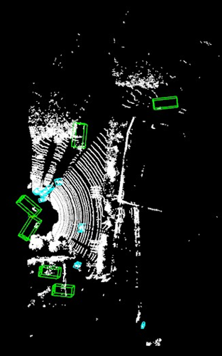
Backbone Network
2D Cascade RCNN
They fine-tune Cascaded RCNN pre-trained model on COCO with 6 epochs on Kitti.
Trained for 4 epochs
3D PV-RCNN
They pre-train PV-RCNN about 60 epochs on the KITTI dataset “learnable weights randomly initialized”
Found pre-trained PV-RCNN model for 80 epochs

Slide 8
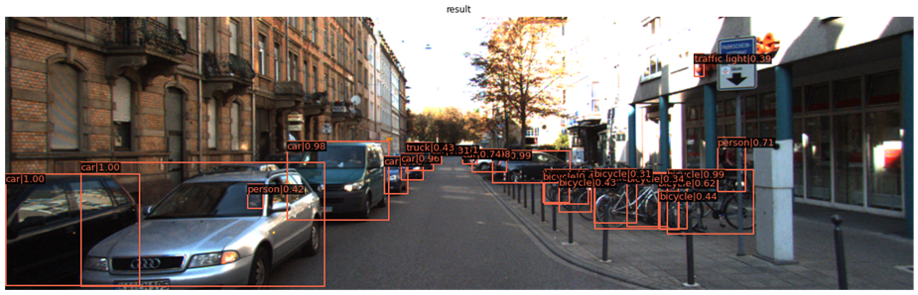
Cascade RCNN
This result is for the initial model that trained on COCO dataset.

Slide 9
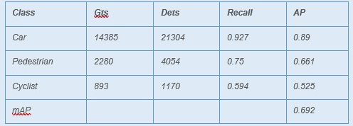
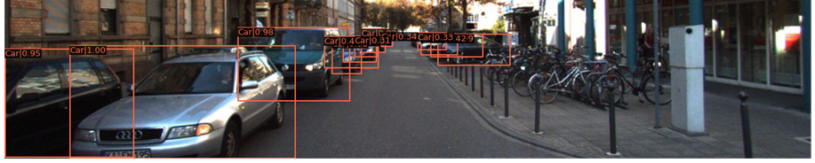
Cascade RCNN 2 Epochs

Slide 10
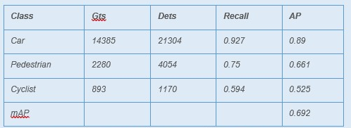
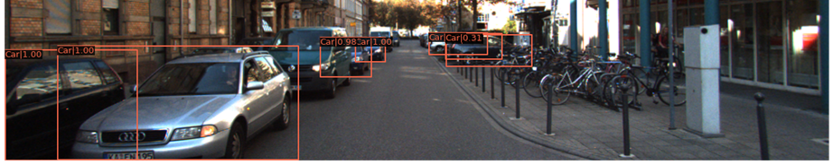
Cascade RCNN 4 Epochs
Notes:
Note: while training, number of detections became closer to ground truth but recall and AP became lower. Maybe it needs to train more and use different learning rate and different threshold as well. Currently used threshold is 0.5.

Slide 11
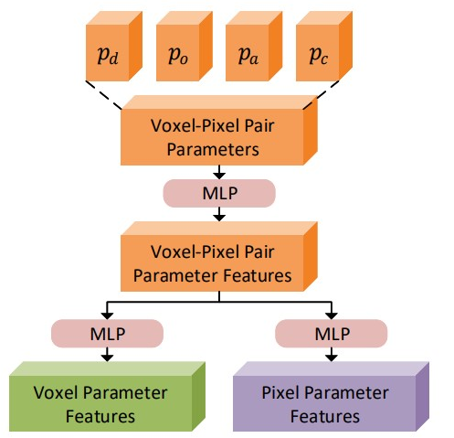
Parameter Feature Generating Module
It’s to generate parameter features to represent the deterministic characteristics of each voxel-pixel.
Density parameter
Occlusion parameter
Area parameter
Contrast parameter
Notes:
Problem: · Hard to get all voxels from PV-RCNN to calculate occlusion parameter and area parameter as I couldn’t understand all its implementation steps in right way.

Slide 12
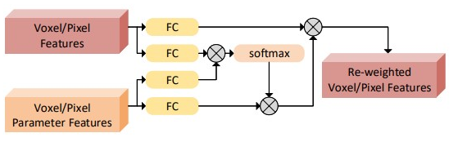
Parameter-Based Weighting Module
Voxel/Pixel Features
Notes:
These features would be used to initiatory re-weight the voxel features from the LiDAR feature map and the pixel features from the camera feature map. Features of a voxel coming from the LiDAR/Camera feature map are expressed by bv/bp.

Slide 13
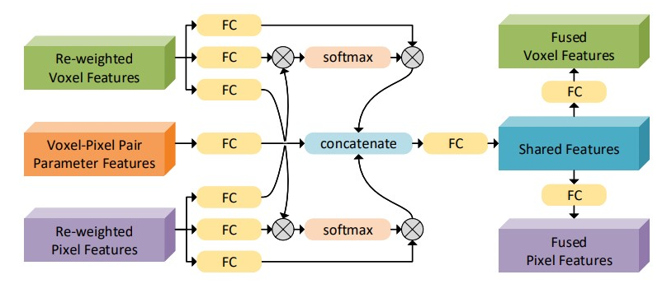
Voxel-Pixel Fusion Module
Notes:
The re-weighted voxel features, re-weighted pixel features, and voxel-pixel pair parameter features are combined and transformed into the fused voxel features and pixel features. The fused voxel features and fused pixel features, which serve as residuals, are appended to the original features. Finally, fused feature maps substitute the original feature maps and return to backbone networks.

Slide 14
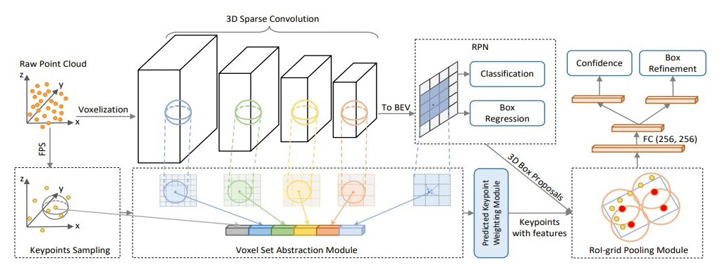
PV RCNN
Notes:
In the paper, for 3D backbone network side, they mentioned that they insert the VPF layer to the first, the second, or the third down-sampling layer. The results show that bridging the VPF layer on the second down sampling layer pair for all the classes is the best choice.

Slide 15
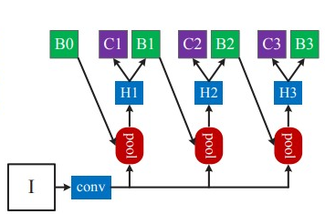
Cascaded RCNN
“I” is input image, “conv” backbone convolutions, “pool” region-wise feature extraction, “H” network head, “B” bounding box, “C” classification. “B0” is proposals in all architectures.

Slide 16
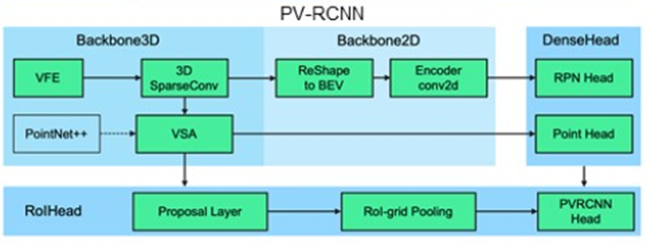
Unresolved Problems
Hard to get all voxels from PV-RCNN to calculate occlusion parameter and area parameter as I couldn’t understand all its implementation steps in right way. This figure is the illustration of the implementation in OpenPCDet, I couldn’t understand outputs of some modules which made me not able to use it.

Slide 17
Unresolved Problems
Dimensions problem when implementing forward function for VPFNet due to differences between PV-RCNN and Cascaded RCNN as they used different dimensions and I couldn’t change them.

Slide 18
Code
In this folder on drive Data and models uploaded in it, and there are 5 notebooks:
Data preparation
Visualization “work only locally”
Cascaded RCNN “to run and fine-tune it”
PV RCNN “to run the demo of the model”
VPFNet “to build the model, its modules and use previous two models”
Note: they will run correctly with OpenPCDet and mmdetection that are in the drive folder as some changes I made in it to make it work correctly on colab.

Slide 19
Thank You

